Slide 1
CSC312
Automata Theory
Lecture # 8
Chapter # 5 (Cont…)
Finite Automata

Slide 2
Ex. The FA that accepts the language with all the strings that do not end with a.
Sol. Do not ends with a = Ends with what?
OR
take the complement of “ends with a”.
Ex-p-68. The language of all the words that have different first and last letter.
Ex-p-65. The FA that accepts only the words baa and ab.
Ex. The FA that accepts only the words baa, ba and ab.

Slide 3
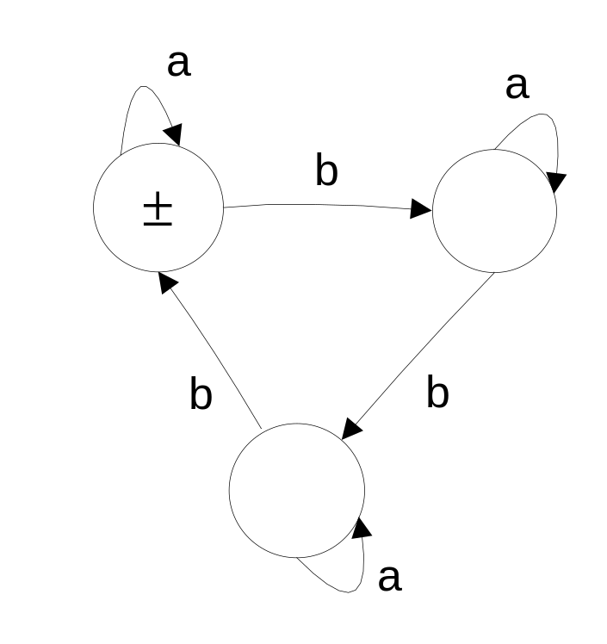
Ex-p-65: What language the following FA accepts i.e. find RE.

Slide 4
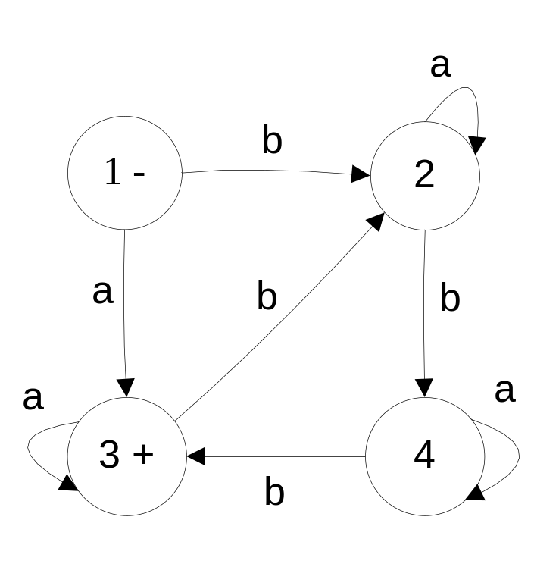
Ex-p-65: What language the following FA accepts i.e. find RE.

Slide 5
Ex: FA for all strings having less than 3 b’s.
Ex: FA for EVEN-EVEN language
RE = (aa+bb+(ab+ba)(aa+bb)*(ab+ba))*
Q.4. (i) Build an FA with three states that accepts all strings.
Q.6. FA that accepts only those word that do no end with ba.
Sol: Do no end with ba = Ends with what?
OR Find FA that ends with ba then take complement.

Slide 6
Q.7: (i) Begin or end with double letter.
(ii) Begin and end with double letter.
Sol: Find FA that begin with double letter
Find FA that end with double letter
Now combine the above two FAs. To find the solution of both the parts.
Q.8: Even number of substring ab
Q.9: (i) FA that accepts the language of all the strings that have both the letter a and the letter b in them, but not necessarily in that order.
(ii) All the strings that have onl a’s or only b’s in them

